Slide 1
Key Computing concepts

Slide 2
Processing and Storage components

Slide 3
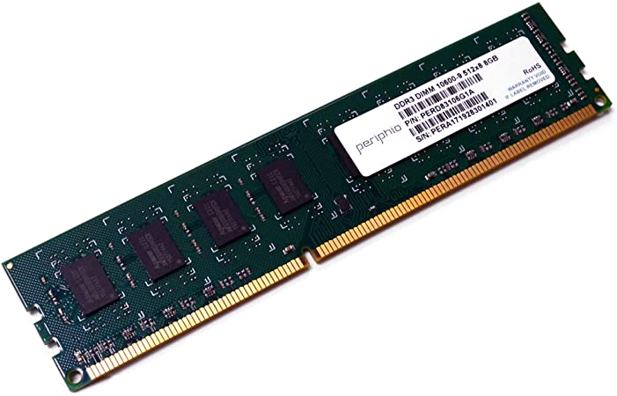
RAM
Very fast
Temporary
Volatile

Slide 4
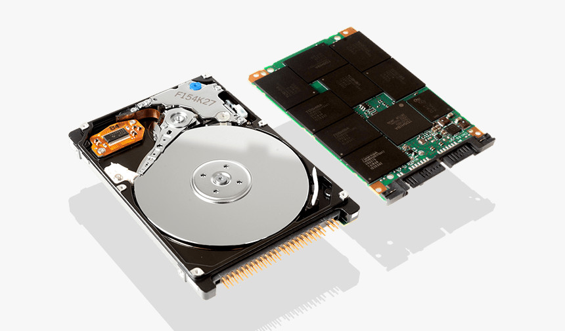
Storage
Slower than RAM
Stores much more than RAM
Permanent

Slide 5
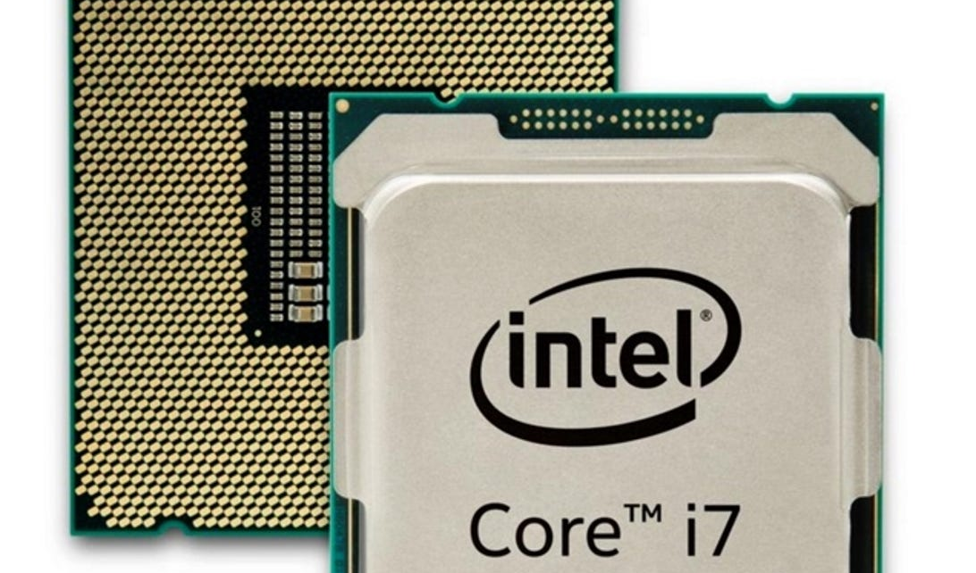
CPU
Performs calculations
Directly communicates with RAM

Slide 6
Data Flow
Storage
RAM
CPU

Slide 7
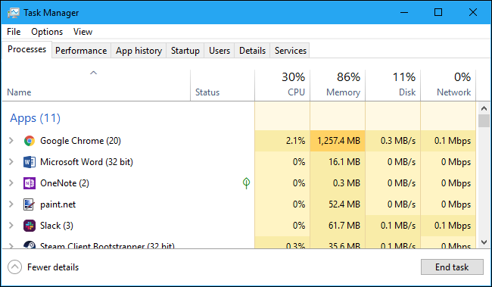

Slide 8
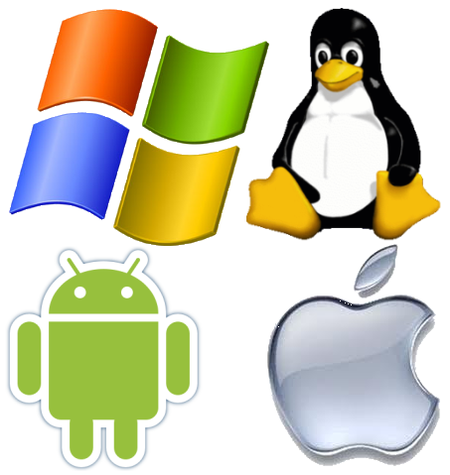
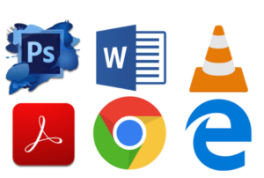
Software
System software
Application software

Slide 9
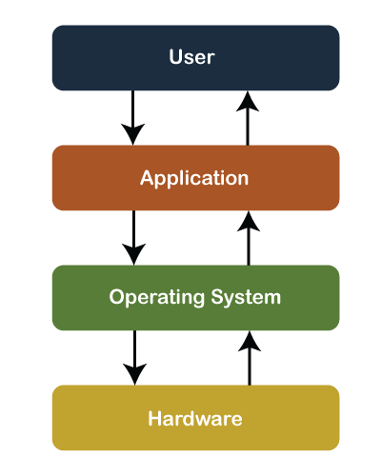
Operating system

Slide 10
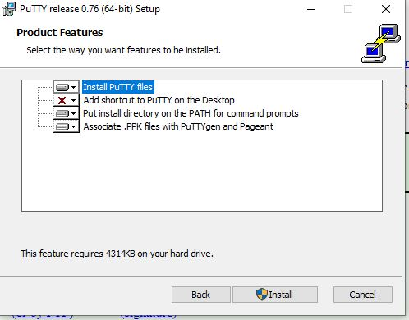
Download vs install

Slide 11

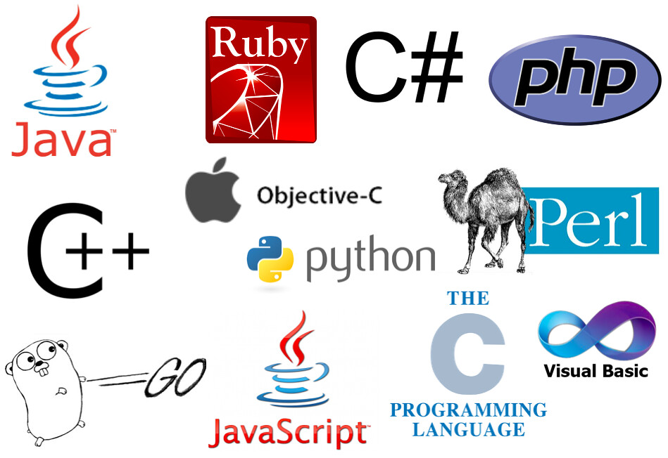
Programming languages

Slide 12
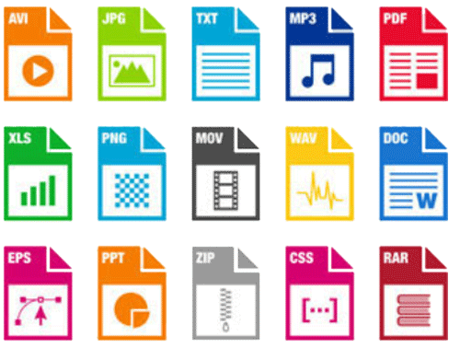
Files and Folders
File: computer resource for storing data or information.
Folder: a collection of files.

Slide 13
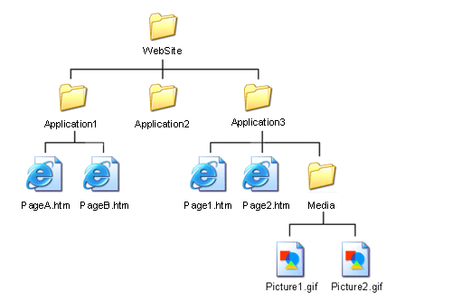
File path

Slide 14
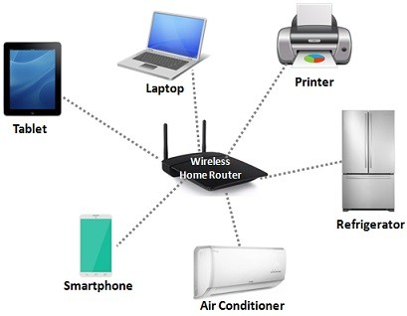
Network
10.0.0.1
collection of computers and other electronic devices connected with each other to allow data sharing.
10.0.0.2
10.0.0.3

Slide 15



The internet

Slide 16
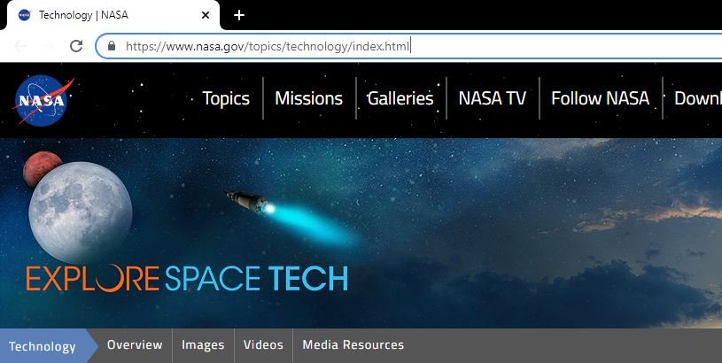
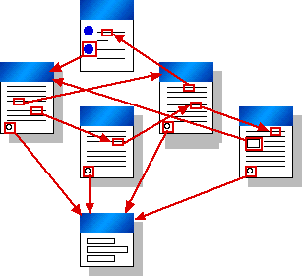
Internet vs Web(WWW)

Slide 17

Server
a computer with powerful resources used for serving data to other computers/devices

Slide 18


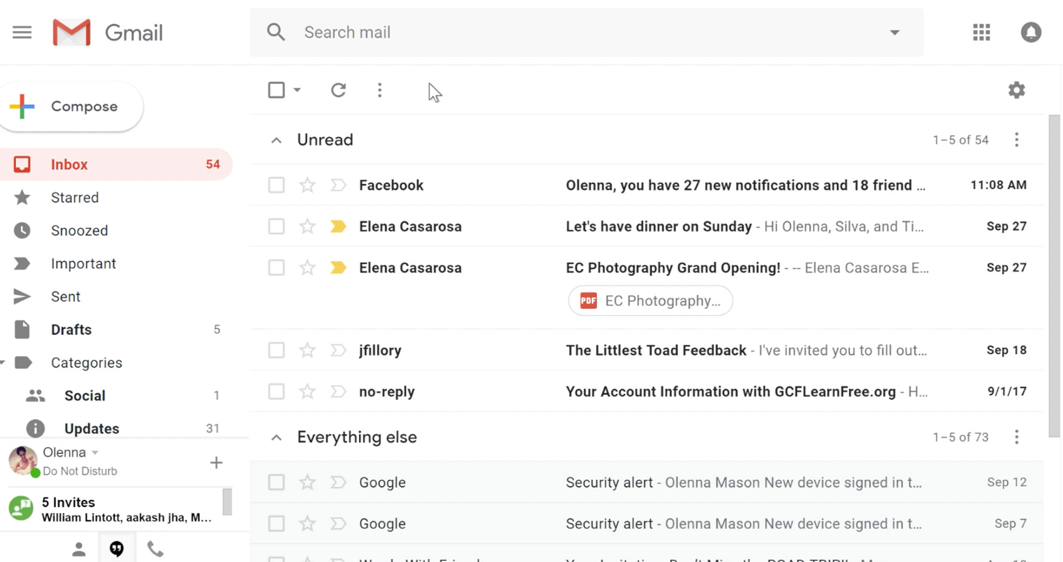
Game Server
Web server
Email Server

